Slide 1
NOAA Fisheries
Habitat Restoration
Infrastructure Funding

Slide 2
NOAA Fisheries
Habitat Restoration Specific Language from IIJA
(2) $491,000,000 shall be for contracts, grants, and cooperative agreements to provide funding and technical assistance for purposes of restoring marine, estuarine, coastal, or Great Lakes ecosystem habitat, or constructing or protecting ecological features that protect coastal communities from flooding or coastal storms;
$98.2M per year available for 5 years
(14) $400,000,000 shall be for restoring fish passage by removing in-stream barriers and providing technical assistance pursuant to section 21 of the Magnuson-Stevens Fishery Conservation and Management Reauthorization Act of 2006 (16 23 U.S.C. 1891a), of which up to 15 percent shall be reserved for Indian Tribes or partnerships of Indian Tribes in conjunction with an institution of higher education, non-profit, commercial (for profit) organizations, U.S. territories, and state or local governments, and of which the remaining amount shall be for all eligible entities, including Indian Tribes and such partnerships of Indian Tribes:
$80M per year available for 5 years

Slide 3
Other Related NOAA Funding
National Ocean Service/Office for Coastal Management
  $492,000,000 for National Oceans and Coastal Security Fund grants (aka National Coastal Resilience Fund through NFWF)
  $207,000,000 for Coastal Zone Management habitat restoration projects*
  $77,000,000 for habitat restoration projects through the National Estuarine Research Reserve System*
* Includes Coastal and Estuarine Land Conservation Program (CELCP)

Slide 4
Some Near-Term Issues
Near-Term Actions -
  Spend plan due to Congress in mid-February -- will need to wait for green light from Congress before proceeding
  Partner outreach
  Tribal Outreach
Notice of Funding Opportunity
  Likely two competitive solicitations (“NOFOs) in latter half of year
  Multi-year awards/partnerships
  Matching funds will be encouraged but not required
Collaboration with NOAA’s Office of Coastal Management and NFWF
Collaboration with other Federal agencies

Slide 5
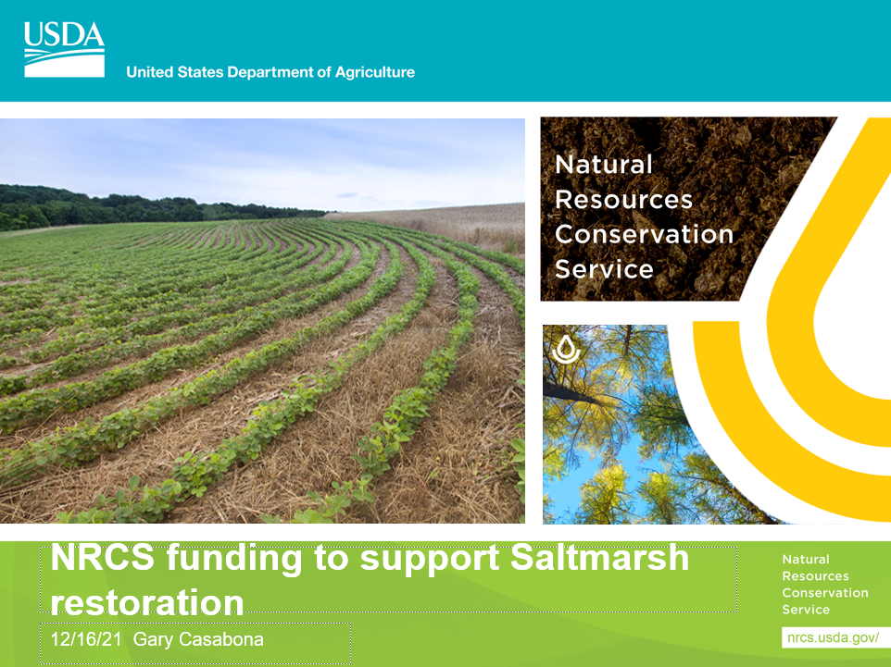

Slide 6

There is no information yet about how Infrastructure funding might affect
NRCS Farm Bill Program dollars.
HOWEVER !!
Most NRCS offices accept applications on a rolling basis, so there is no bad time to start the
process of inquiring about eligibility and putting in an application when appropriate.
Of the many NRCS Farm Bill programs, two are the likely best fit for most potential Saltmarsh
Restoration and/or Easement Acquistion projects. These are:
Wetland Reserve Easements (WRE) -- formerly WRP
Environmental Quality Incentives Program (EQIP)

Slide 7
Wetland Reserve Easements:
Land must have a history of agriculture at some point in time (e.g., salt haying)
Must either include degraded wetland that can be restored
OR
The easement must fill a gap in an otherwise protected riparian corridor
NRCS can typically pay 100 percent of restoration costs after closing on the easement
Landowner can continue to enjoy passive recreation (e.g., hunting, fishing, hiking).
Can also propose “compatible use agreement” for other activities, such as timber
harvest

Slide 8
Environmental Quality Incentives Program (EQIP)
Reimburses 75 to 90 percent of estimated costs (from payment schedule)
for installation of conservation practices such as Tidal Channel Restoration, Runneling, etc.
Reimbursement only AFTER installation and inspection of practices
Application from either the private landowner or an operator (e.g., farmer) who has been given
Management control of the land for the length of a contract
Local NRCS staff can discuss/determine eligibility for either WRE or EQIP

Slide 9
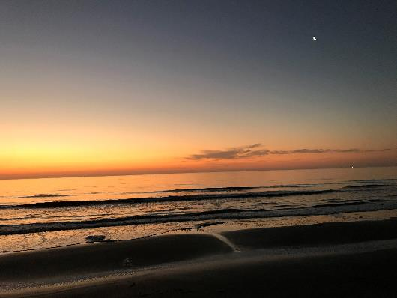
U.S. Army Corps of Engineers
Summary of coastal habitat funding:
Infrastructure Investment and Jobs act (IIJA)
Mindy Simmons
Senior Policy Advisor
Planning & Policy Division, HQUSACE
16 DEC 2021
Photo: Debby Scerno

Slide 10
SUPPLEMENTAL/INFRASTRUCTURE OVERVIEW
  Disaster Relief Supplemental Appropriations Act (“Ida Supplemental”):
      No significant Aquatic Ecosystem Restoration (AER) funding
      Scope is primarily Flood Risk Management (FRM) and Navigation (NAV)
  Infrastructure Investment and Jobs Act (“American Jobs Plan”): $17.099 Billion
      Investigations (studies) = $150M
        $75M- complete or initiate previously-authorized studies
        $30M- comprehensive Plans in cooperation with states
        $45M- Floodplain Management Services (FPMS)
        $30M- Pilot Program for WRDA Sec 118 FRM and hurricane storm damage risk reduction for rural and economically disadvantaged communities
      Construction = $11.615B
        $465M for Continuing Authorities Program (CAP); many purposes allowed, small scope
Notes:
INVESTIGATIONS - $150 million – remains available until expended (no specifications on business line)
• Of the Account $30 million shall be used to undertake work in cooperation with any State, group of States, or non-federal sponsor representing a State, in the preparation of comprehensive plans for the development, utilization, and conservation of the water and related resources of drainage basins, watershed, or ecosystems located within the boundaries of that State. (Sec 22 of WRDA 1974, as amended; 42 U.S.C. 1962d-16)
• Of the Account $45 million shall be used for activities under the Corps Flood Plain Management Services Program (Sec 206 of the Flood Control Act of 1960, as amended)
• Of the Account $75 million shall be used to complete OR initiate and complete studies that were authorized prior to the date of this Act
• Of which $30 million, to become available on 01-OCT-2022, shall be used to implement the pilot program authorized under Sec 118 of WRDA 2020 – Evaluation of opportunities to address the flood risk management and hurricane and storm damage risk reduction needs of rural communities and economically disadvantaged communities. (Legislation outlines requirements for spend plans; removes limitation on number of studies authorized to be carried out under Sec 118(b) and 118(c); establishes briefing/reporting requirements)
Construction- CAP- could include projects like Spring Creek North Sec 1135, incl 35 acres of salt marsh restoration.

Slide 11
IIJA CONSTRUCTION FUNDING OVERVIEW
  USACE funding for coastal habitat is provided through three mission areas, or “business lines”
    Aquatic Ecosystem Restoration (AER)
      Salt marsh creation, beneficial use for restoration purposes
        Poplar Island, Lower Cape May Meadows
    Navigation (NAV)
      Beneficial Use of Dredged Material (e.g., Barnegat Bay)
    Flood Risk Management/Coastal Storm Risk Management (FRM/CSRM)
      Beach renourishment, marsh creation for coastal storm protection

Slide 12
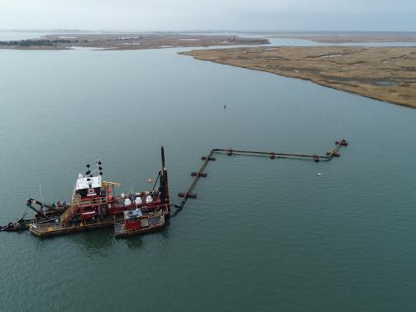
IIJA CONSTRUCTION FUNDING- Navigation
  $1.5M for Coastal Navigation
    No specific language for beneficial use, but…
    USACE Navigation Program has issued guidance stating beneficial use is a priority
    USACE Chief of Engineers is placing a high priority on increasing beneficial use
    WRDA 2020 Sec 125:
      Establishes policy to maximize beneficial use of dredged material
      Requires consideration of beneficial use alternatives for all USACE navigation projects and documentation of benefits calculation
      Allows for federal funding above the Federal Standard (i.e., least-cost, env-acceptable alternative)
      Requires preparation of Dredged Material Management Plans
Barnegat Bay, NJ

Slide 13
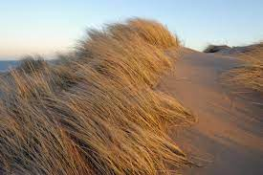
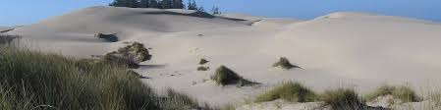
IIJA CONSTRUCTION FUNDING-
Coastal Storm Risk Management
  $2.55M for Coastal Storm Risk Management
    $1B for “multi-purpose”
      most CSRM multi-purpose are with aquatic ecosystem restoration)
    $200M for shore protection (i.e., beach projects)
      Funding allocated over 3 years
Barnegat Bay, NJ
Notes:
Note: typical annual appropriation for shore protection is $50M, not typically supported in a budget, only via approps.

Slide 14
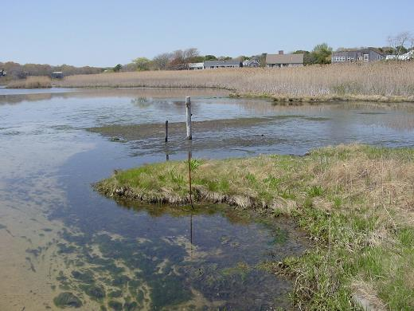
IIJA CONSTRUCTION FUNDING-
Aquatic Ecosystem Restoration
  $1.9 for Aquatic Ecosystem Restoration
    $1B for “multi-purpose”
      Can include coastal storm risk management, navigation, or inland flood risk management
Stewart’s Creek, MA
Notes:
Note: typical annual appropriation for shore protection is $50M, not typically supported in a budget, only via approps.

Slide 15
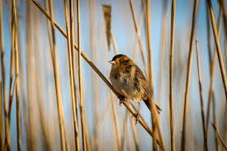
IIJA CONSTRUCTION FUNDING- Opportunities
  No changes in the cost sharing requirements with non-Federal partners (with a few exceptions)
  Prioritization process is similar to typical appropriations
    USACE -> Army -> Office of Management and Budget
    Significant opportunities with recent WRDA legislation to increase beneficial use
  Consider Admin priorities for climate resilience, environmental justice, Tribal nations
  No restrictions on the number of new projects to start
    Typically USACE is limited to 6-8 per year
Notes:
Note: typical annual appropriation for shore protection is $50M, not typically supported in a budget, only via approps.

Slide 16
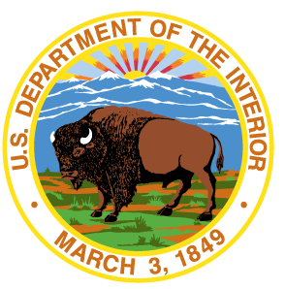
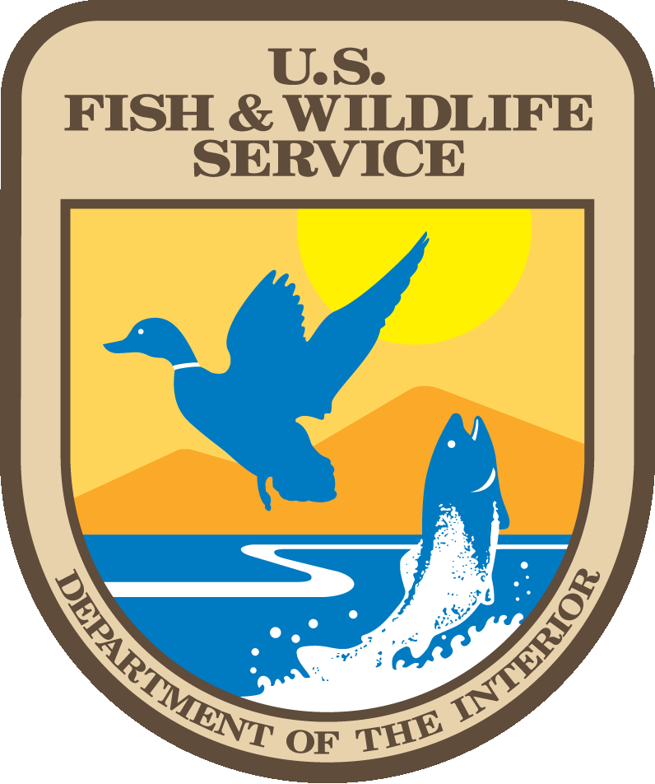
Infrastructure Funding
DOI Department-wide Programs
FWS: $455 million for Resource Management, with $91 million made available each year from FY22-26. Funding shall be available until expended and used for the following purposes:
  $26 million for Delaware River Basin Conservation Act
  $200 million for restoring fish and wildlife passage by removing in-stream barriers and providing technical assistance under the National Fish Passage Program, in equal amounts for each year FY 2022 to FY 2026.
Sec. 40804. Ecosystem Restoration. Authorizes $2.13 billion for DOI and USDA for FY22-26 to restore the ecological health of Federal lands and waters and of private lands

Slide 17
Opportunities
  $200 million available to the Secretaries to restore the ecological health of no less than 10,000 acres of Federal land ($50 million for DOI; $150 million for USDA).
  $200 million to the Secretaries to provide to States and Tribes for implementing restoration projects on Federal land pursuant to good neighbor agreements ($40 million to DOI; $160 million to USDA).
  $400 million shall be made available to DOI to provide grants to States, Territories, and Tribes for implementing voluntary ecosystem restoration projects on private or public land, in consultation with USDA.
  $100 million available to restore, prepare, or adapt recreation sites on Federal land, including Indian forest land or rangeland ($45 million for DOI; $35 million for USDA).
  $100 million each available to the Secretaries to restore native vegetation and mitigate environmental hazards on mined land on Federal and non-Federal land.
  $200 million available to the Secretaries to establish and implement a national revegetation effort on Federal and non-Federal land, including implementing a National Seed Strategy ($70 million for DOI; $130 million for USDA).
  $80 million available to the Secretary of Agriculture, in coordination with the SOI, to establish a collaborative, landscape-scale restoration program to restore water quality or fish passage on Federal land.

Slide 18
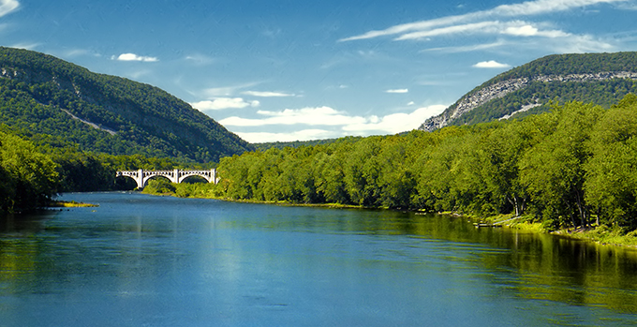
Delaware River Basin Restoration Program
Notes:
Thanks Scott, we appreciate the opportunity to discuss the Service’s Delaware River Basin Restoration Program

Slide 19
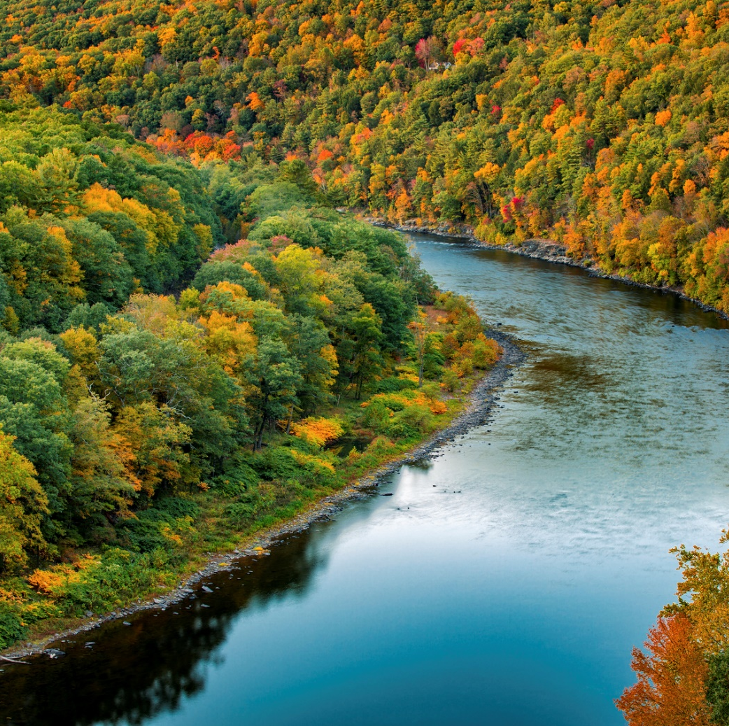
Conserving the Delaware
PUBLIC LAW 114–322: Waters Infrastructure Improvements Act for the Nation passed in December 2016
Bill included subtitle E. Delaware River Basin Conservation, which charged the U.S. Fish and Wildlife Service with creating the Delaware River Basin Restoration Program (DRBRP)
The program has 3 components, a partnership, a grant program and a watershed wide conservation strategy
Notes:
Enacting legislation – empowers USFWS to create the DRBRP and mandates 3 components to the program. The Partnership, the grant program and the conservation strategy.

Slide 20
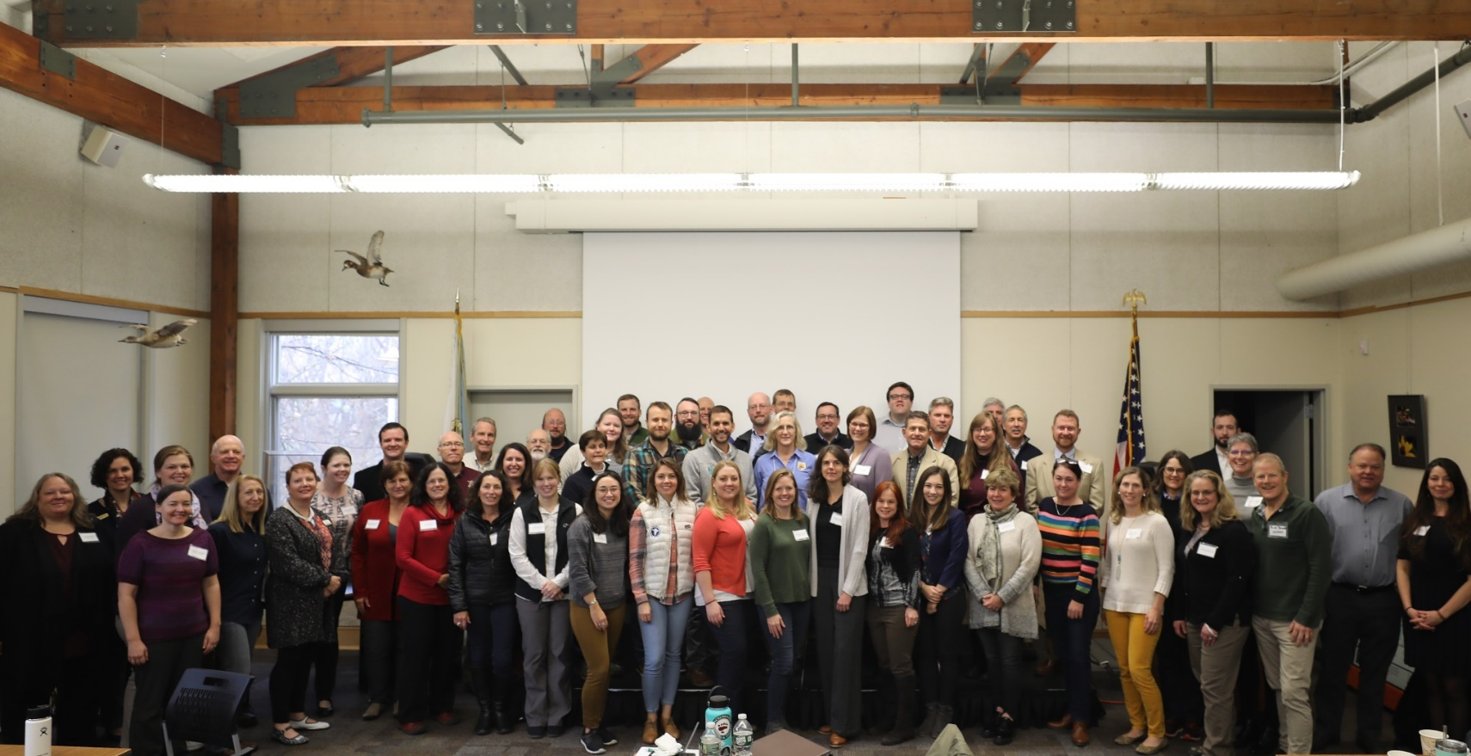
Delaware River Watershed Conservation Collaborative
Our mission is to inspire, coordinate and actively support watershed-wide collaborative and strategic actions by partners and stakeholders throughout the Delaware River watershed, to achieve agreed upon conservation, restoration and public outdoor-recreation access outcomes.
Notes:
In late 2020, the Service launched the Delaware River Watershed Conservation Collaborative (DRWCC) to help grow and support an inclusive partnership of conservation practitioners who can achieve more by working together. The Collaborative’s mission is to inspire, coordinate, and actively support watershed-wide collaborative and strategic action to achieve shared conservation, restoration and public outdoor-recreation access outcomes.
The Collaborative's steering committee is made up of representatives from Federal, State, NGO and local organizations. At present, the Steering Committee is still forming and seeking individuals to fill several open seats and help lead conservation action in the watershed.

Slide 21
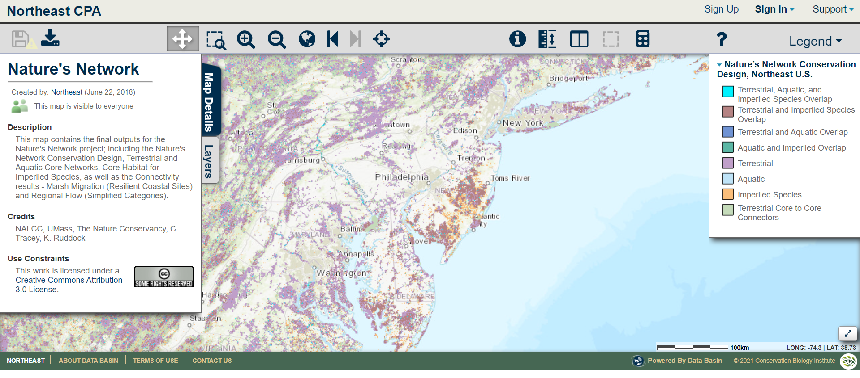
Delaware River Watershed Conservation Blueprint
Notes:
The US Fish and Wildlife Service and our partners have worked to closely to develop Nature’s Network, a spatial tools which identifies the best opportunities for conserving and connecting intact habitats and ecosystems and supporting imperiled species to help ensure the future of fish and wildlife across the Northeast region.
Our plan for the Delaware River Conservation Blueprint is to optimize Nature’s Network, enhancing the platform with more Delaware watershed specific data so that we can create a conservation strategy which will include bold goals and tracking metrics which will guide the investments of the Delaware Watershed Conservation Fund.
I see an opportunity here to incorporate any SALS – really short – decision from SC to develop a blueprint, a conservation design for the watershed

Slide 22
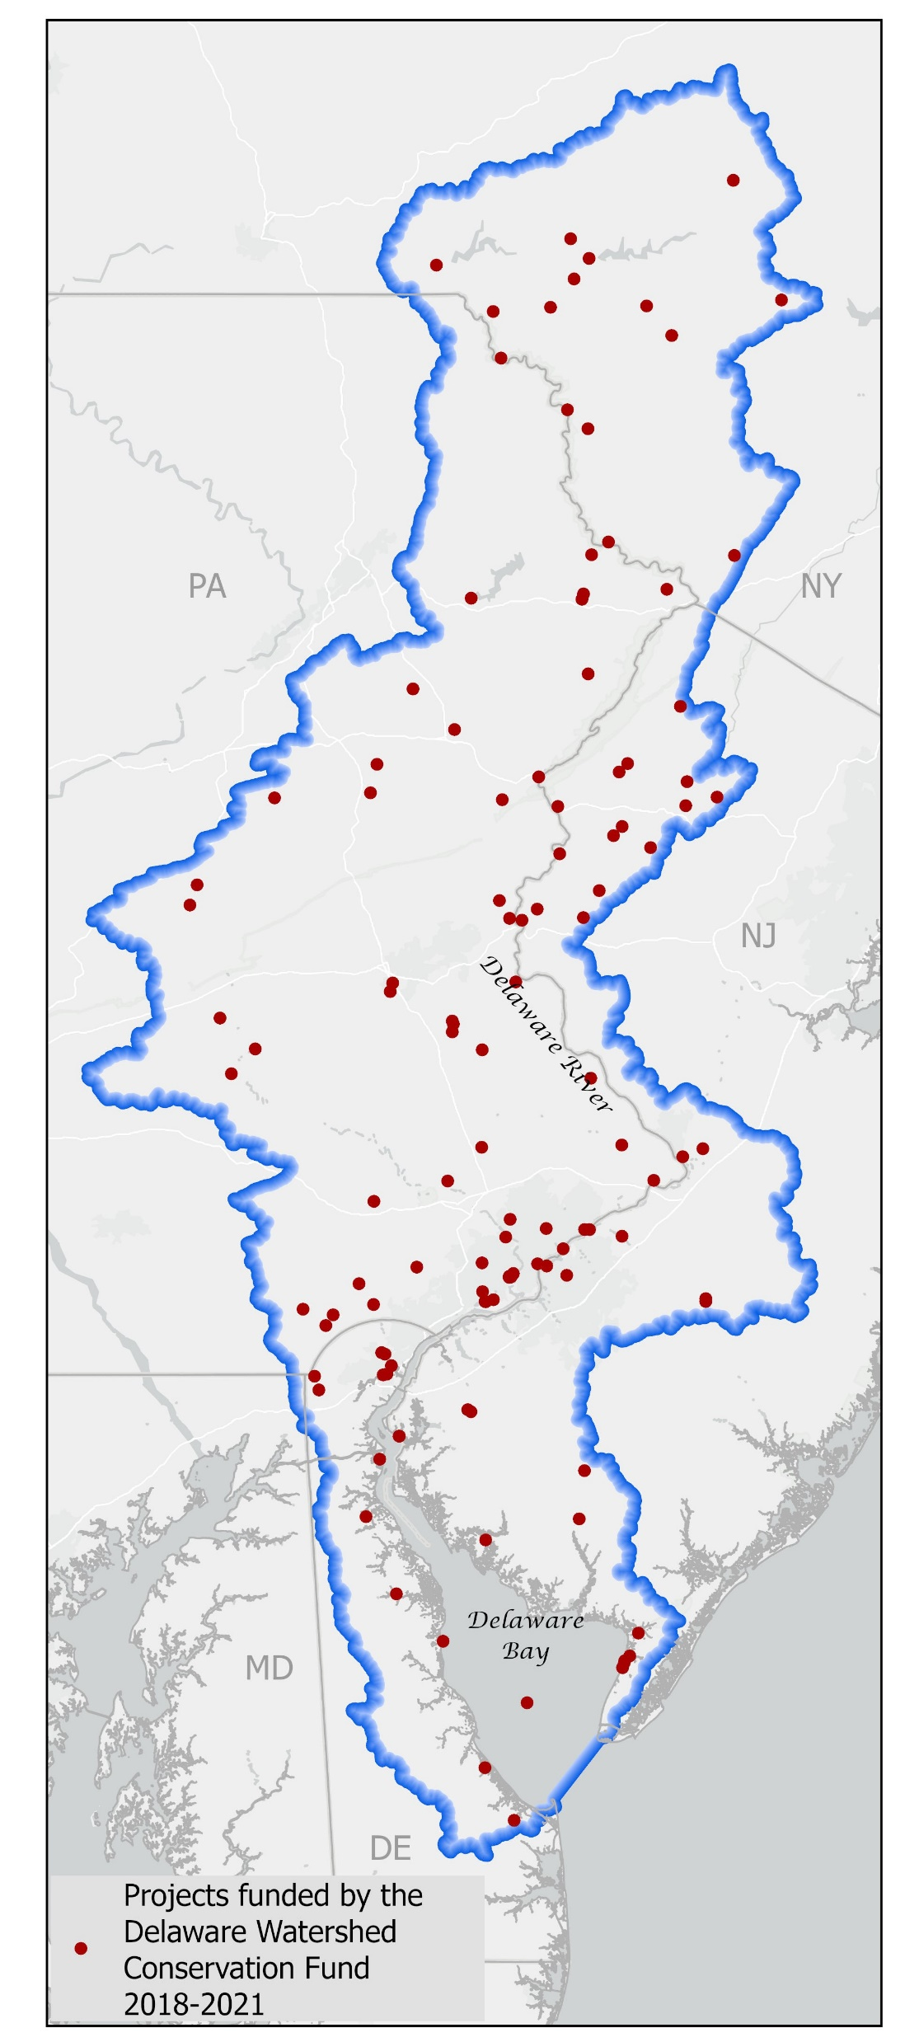
Delaware Watershed Conservation Fund
Since 2018 the fund has:
Funded 123 projects
Awarded $26.2 million in federal funds
Helped partners leveraged $46 million in matching funds
Conservation impact of $72.6 million across the watershed
Created 120 jobs
Notes:
The grant program

Slide 23
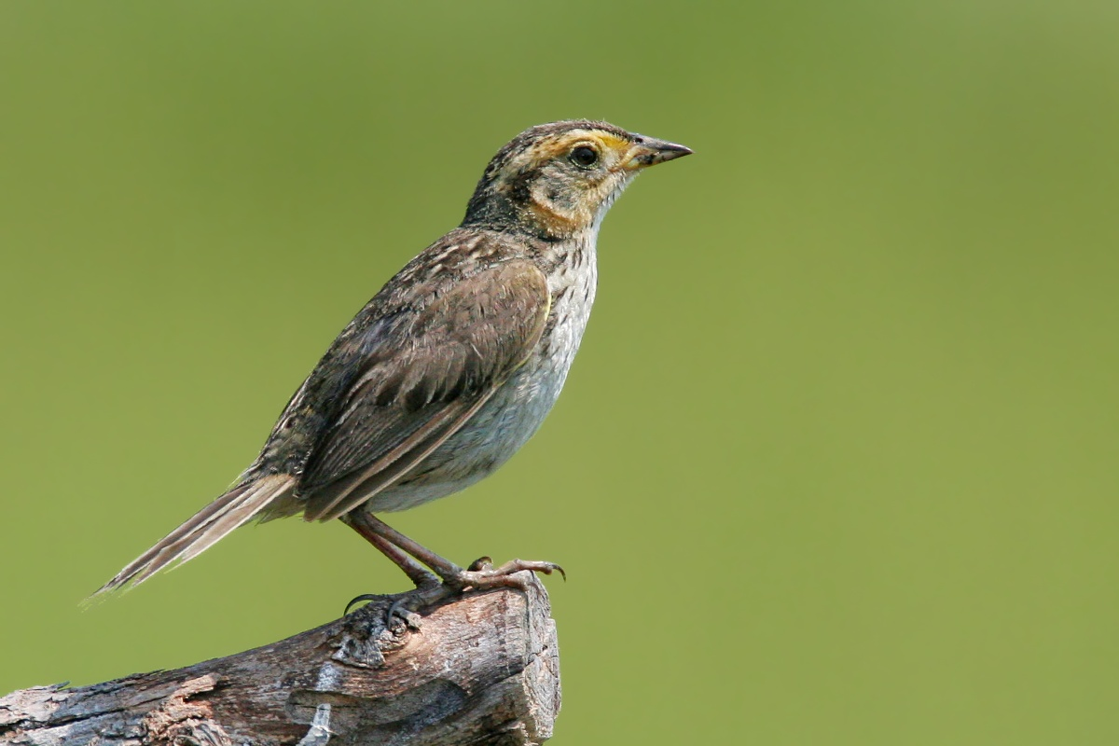
Projects that benefit SALS
Since 2018 the program has funded 4 projects, investing over $1 million in conservation action that benefit SALS.
Partners provided over $1.2 million in match for a total conservation investment of $2.2 million in work to benefit SALS.
Partners involved in these projects include:
  American Littoral Society
  Partnership for the Delaware Estuary
  Ducks Unlimited
  USFWS
Notes:
Advancing Restoration of Horseshoe Crab and Shorebird Habitat in Cape May and Cumberland County, NJ (65049);
Improving Habitat Quality for Horseshoe Crab and Red Knot in Cape May County, NJ (68708),
Cover Crop Improvements for Increased Water Quality and Foraging Opportunities in Kent County, DE (68966),
Tidal Marsh Restoration at Reeds Beach, NJ (69031), Wildlife Habitat Restoration and Agricultural Community Engagement in Cape May County, NJ (69699)
The DWCF did receive a proposal from NJ Audubon in 2021 which proposed to work with NRCS to modify existing conservation practices to integrates salt marsh conservation into their incentive, therein benefitting both Salt marsh sparrow and black rail.
programs.

Slide 24
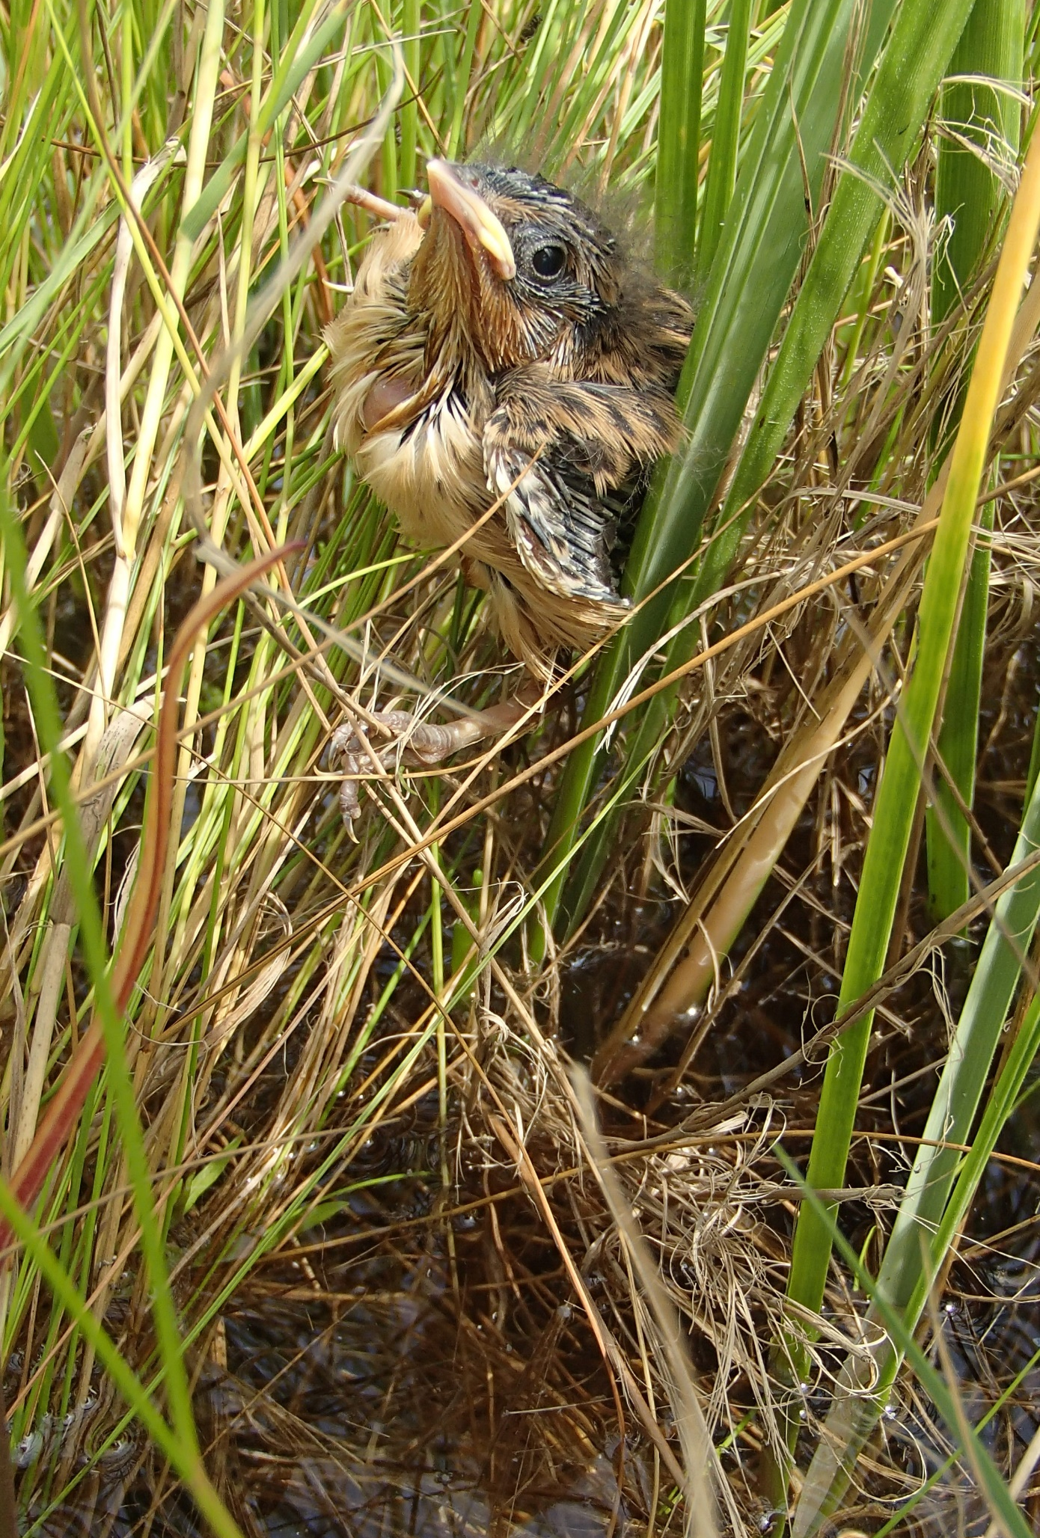
DWCF -What’s new in 22
~$14 million available to award
Three priority areas in the RFP that could fund SALS work:
Infrastructure funds - $4 million for nature-based solutions
Species focus – proposals addressing At-Risk species needs are considered are more competitive
Incubation & Investment – monitoring and research eligible
Notes:
There will be several updates to the 2022 RFP, these include:
Slide that says – relatively new element is incubation and investment component:
Incubation and investmenr – where we hope to see big ideas for invv
olvative conservation measure, networked mentoring capability
SALS work in 3 areas – Innovation, incubation

Slide 25
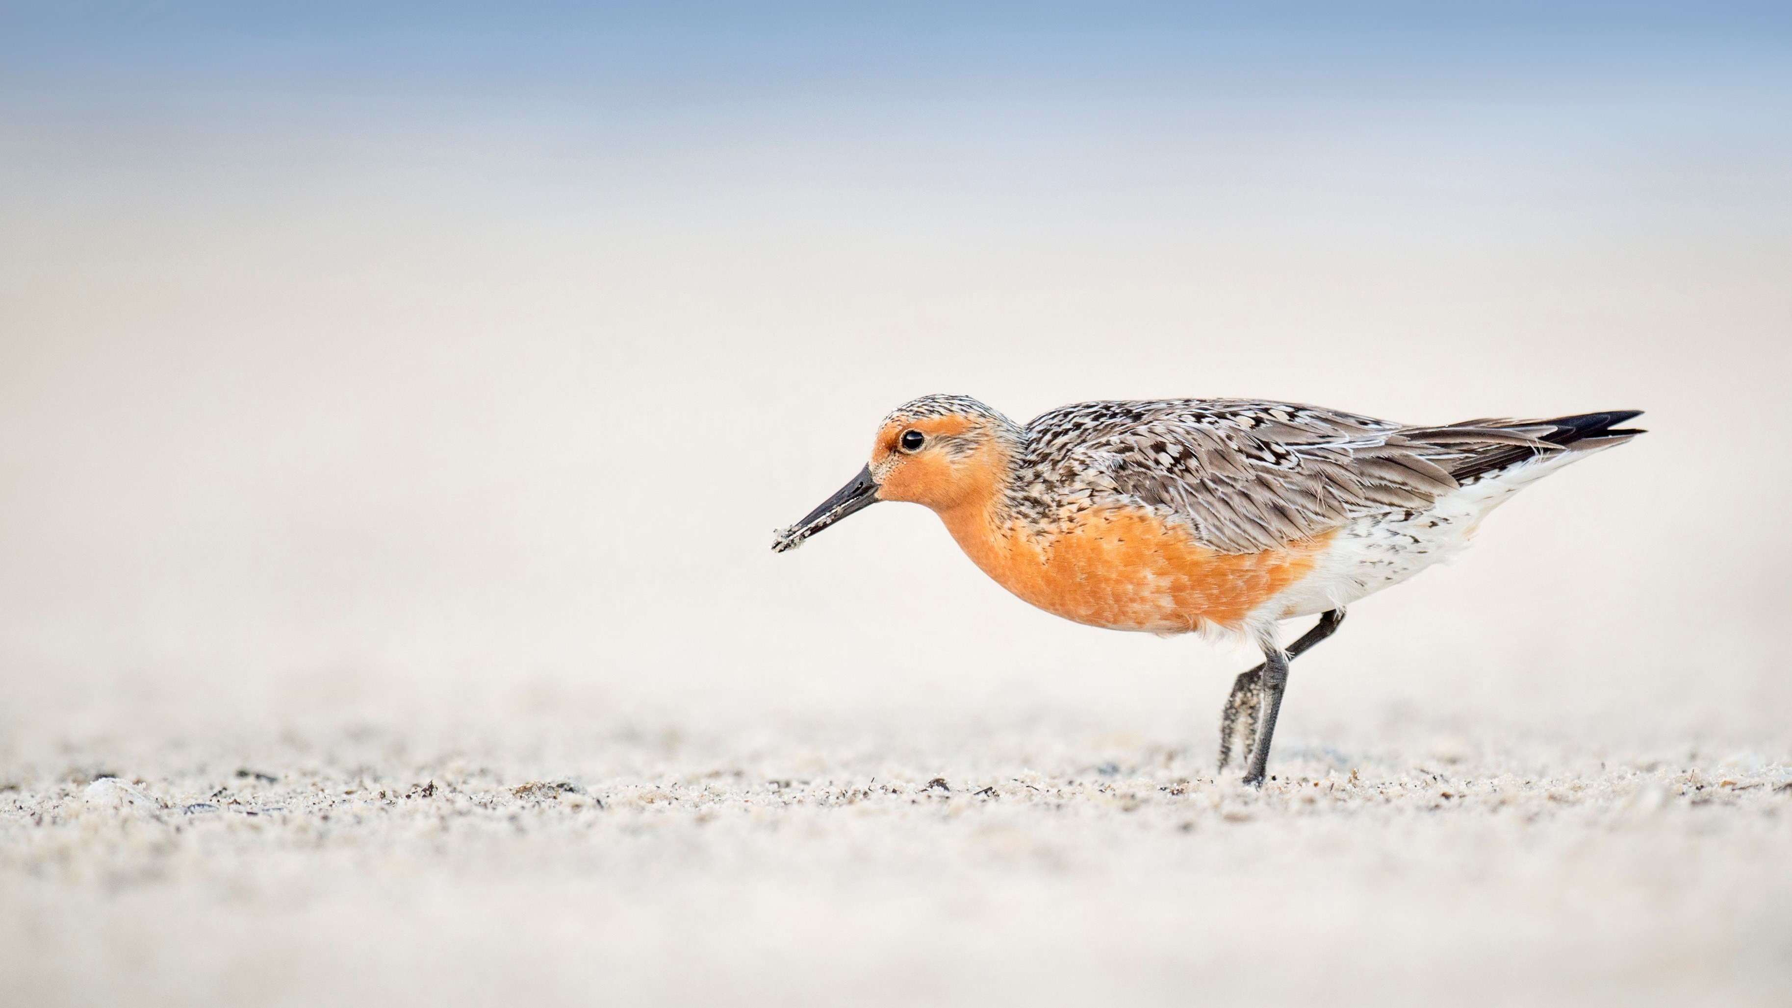
Delaware River Watershed Conservation Fund
~ $14 million to award in 2022
RFP opens in February 2022
Project proposals are due in April 2022
Funding awards are made in August 2022

Slide 26

Proposal Lab
Applicant coaching with NFWF, USFWS & Cardno
Starting January 2022
On-line request form
Please solicit opportunity to your networks
Notes:
This year we are adding a proposal lab opportunity.
Mike and I along with NFWF will hold office hours to work with partners on proposal ideas, hear pitches, discuss activity eligibility, connect match resources, etc.
We will start office hours in January
I will prep an email with he link to the proposal lab schedule request form and ask that you please distribute this opportunity through your networks.
https://forms.office.com/Pages/ResponsePage.aspx?id=urWTBhhLe02TQfMvQApUlG6wo2h7URpOrN5Bqhh2DGVUOUNDRFg4QjRBV0pCS1daOVUyVEU0VDJJVS4u

Slide 27
Christina Ryder (She/Her/Hers)
Delaware River Watershed Program Manager
Science Applications
(443) 934-7120
christina_ryder@fws.gov
Mike Slattery (He/Him)
Landscape Conservation Coordinator
USFWS, Science Applications
(202) 870-1072
michael_slattery@fws.gov

