Slide 1
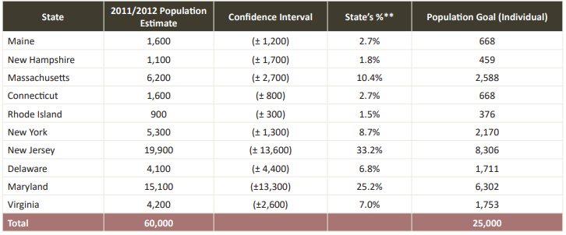
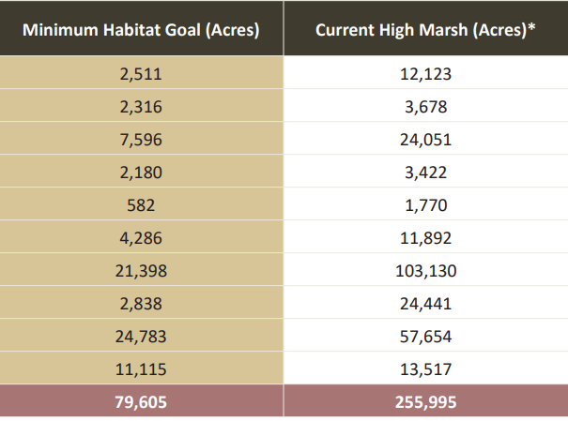
Saltmarsh Sparrow Conservation Plan
Goal: 25,000 sparrows on ~80,000 acres of high quality high marsh habitat

Slide 2
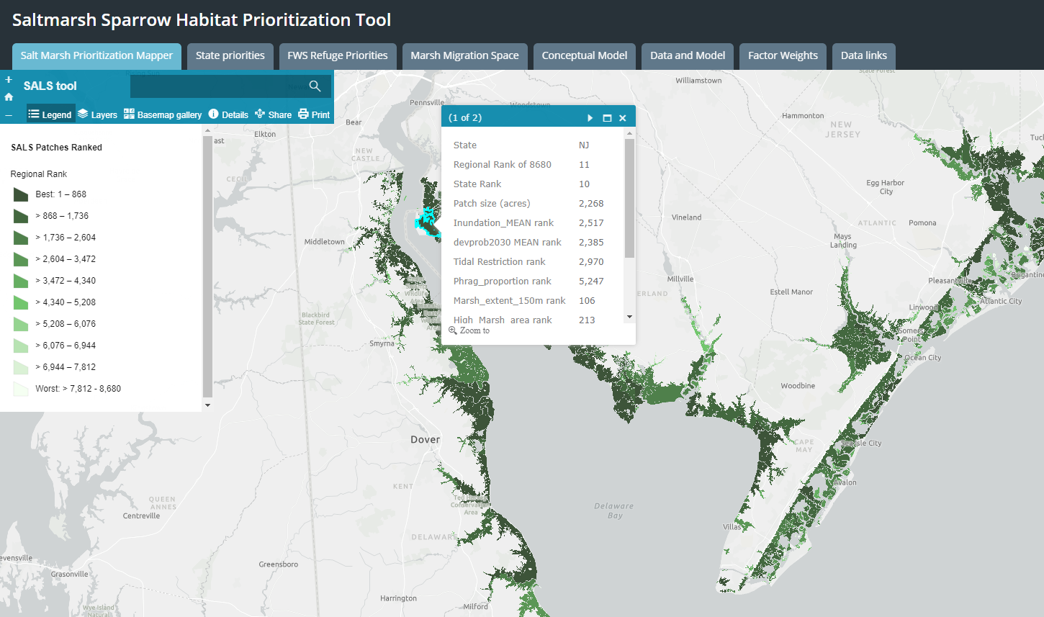
How to Reach our Goal: Where to work

Slide 3

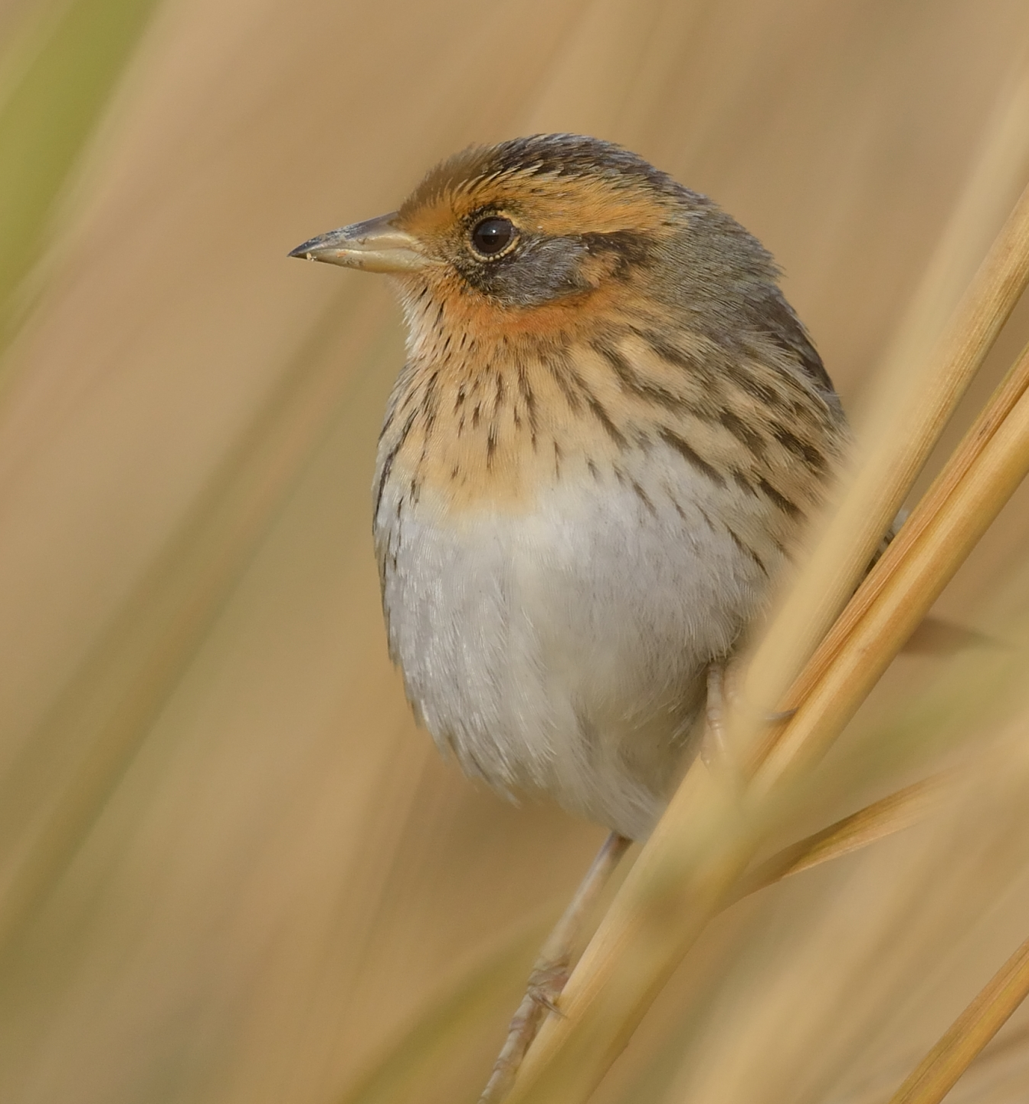
How to Reach our Goal: What to Do
Immediately implement management actions to create high quality habitat and scale up (e.g. thin layer deposition, runnels, ditch remediation)
Remove barriers to implementation (e.g. permitting, funding)

Slide 4
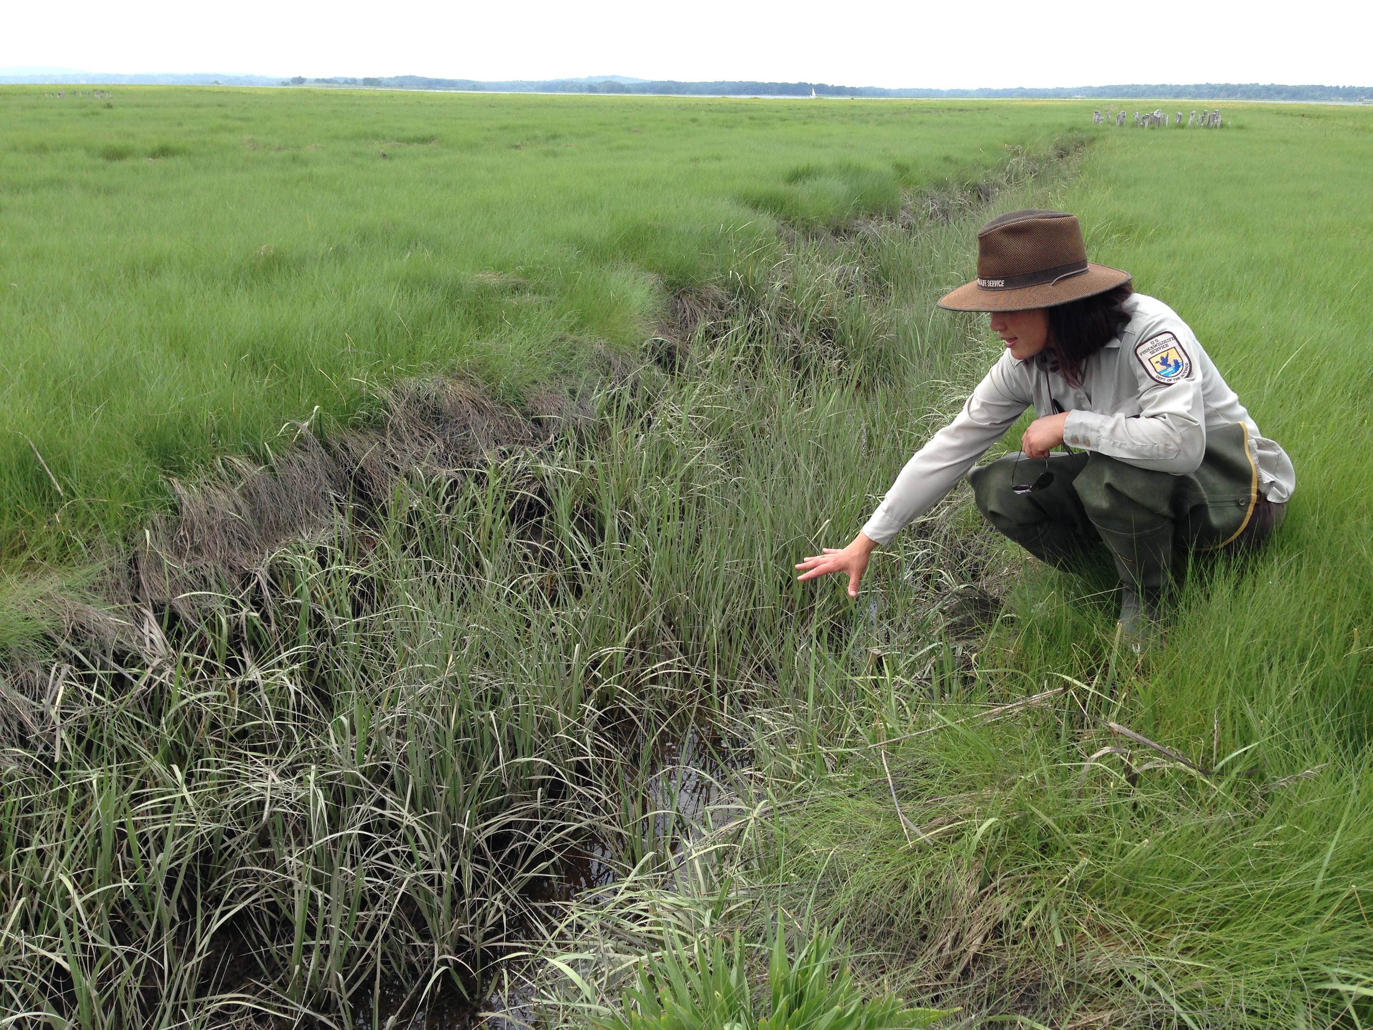
Permitting Challenges
Practitioner feedback:
Permitting delays work by months to years
State and Army Corps permits most challenging
Policy changes are needed (e.g. programmatic permits, allowances to use ‘fill’, etc.)
Dialog and ‘certainty’ is needed for regulators

