Slide 1
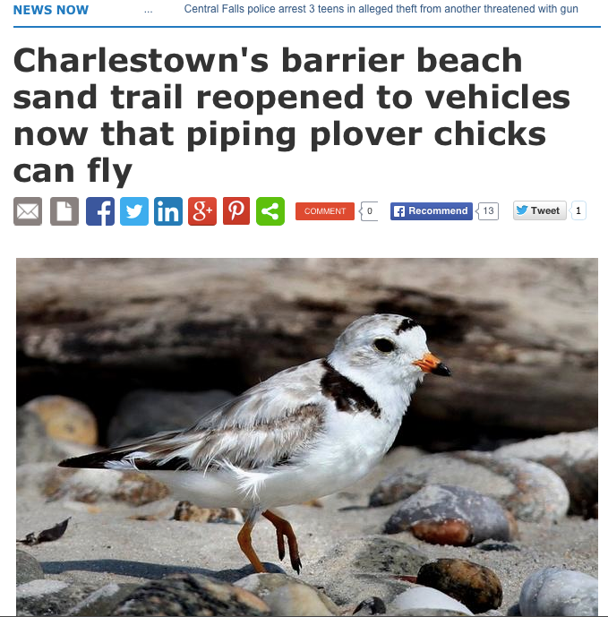

Media Analysis of Piping Plovers
By Dr. Ashley Dayer,
Emily Cosbar, and Alicia Williams

Slide 2
Background Information
Focus of study is to examine media coverage of piping plover along the Atlantic Flyway
Inform Communications Plan for piping plover
Serve as a baseline measure for media coverage, before implementing strategies from new plan

Slide 3
Why Media Analysis?
Media content analysis as “systematic method to study mass media” (Macnamara, 2005)
“The analysis of what is contained in a message” (Prasad, 2008)
  Requires fewer resources than longitudinal surveys with comparable data (Houston et al 2010)
  Media contributes to “agenda-setting” for environmental issues (Houston et al 2010)

Slide 4
Research Questions
What are the predictors of the tone (positive/neutral/negative) in a piping plover article?
How do negative articles differ from positive articles?
What are the messages used in positive articles vs. negative articles?
Is the media company’s rating of tone indicative of the tone when people read the article fully?

Slide 5
Research Methods
Articles were collected by Meltwater Group
  3187 articles from January 2014 through September 2015
  Social media not included in the system
  Provided links, source, circulation, and pre-defined key words
Articles were selected for analysis (n = 199)
  Based on their focus on piping plovers and geography (NE & SE)
  Randomly select one article if re-run in multiple sources
  Articles excluded if no link to full text
Developed coding scheme and two coders read all articles
  Coded for tone of headline, body, quotes, and overall, as well as “enemy framing”, spokesperson, media type, and season
    “Tone” defined positive, neutral or negative attitude towards plovers
  Coders met periodically to discuss their discrepancies

Slide 6

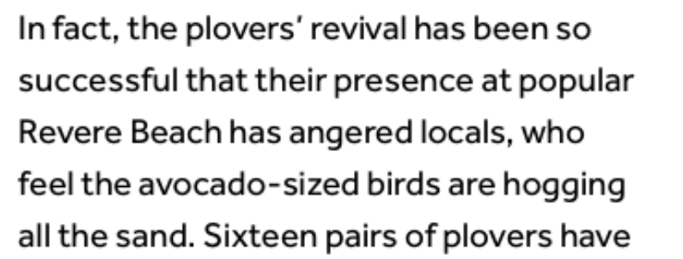
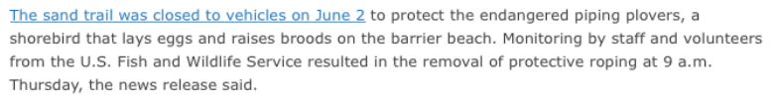

Coding for Tone: Examples in Quotes & Body
+
-
o
-
Notes:
First quote is positive because it supports protecting piping plovers
Second quote is negative because it frames plovers as the enemy
Although the third quote mentions closing a trail to accommodate the plovers, it also mentions protecting the plovers so it is neutral.
Fourth quote is negative because it frames plovers as the enemy and the cause of anger among locals.

Slide 7
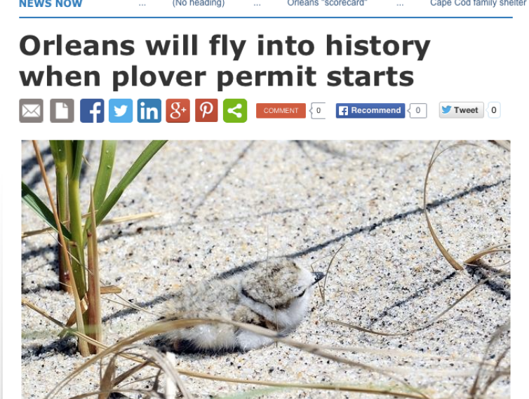
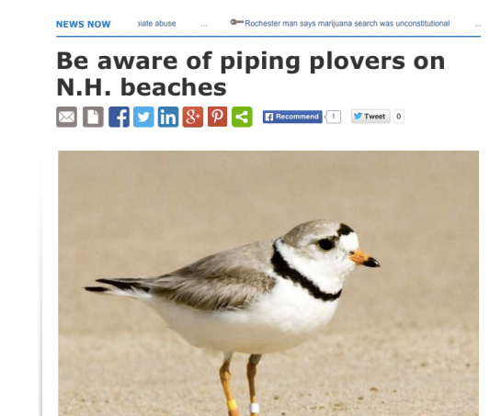
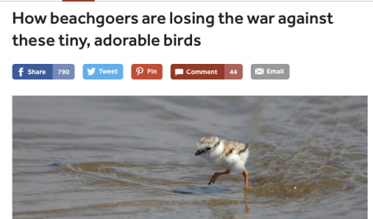
Coding for tone: Examples of Headlines
o
+
-
Notes:
“Be aware of” – Advising caution, implying the birds need to be protected
“Orleans will fly” – Unclear if being in history is positive or negative. Not clearly positive or negative in terms of its attitude towards plover. So a neutral headline.
“How beachgoers are” – Although the birds are described as tiny and adorable, the fact that this headline describes the human/wildlife relationship as a “war” is definitely negative. And a “war against” birds makes the birds sound bad.

Slide 8
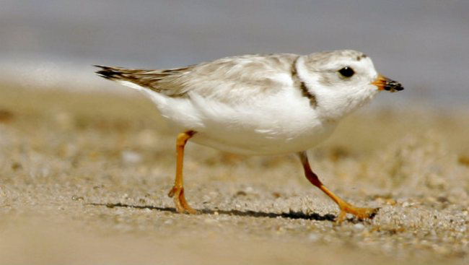
Results: Initial Frequencies

Slide 9
Media Type
Notes:
Of the n=199 articles analyzed, the vast majority were print media type(78%)
11% of the articles were TV.
5% of the articles were “other” media type category, which included magazines and online-based news sources .
3% each of the articles were Op-Ed/Editorial and Radio

Slide 10
Region
Notes:
Most articles (96%) were from the Northeast region (Delaware, Maryland, New Jersey, New York, Massachusetts, Vermont, New Hampshire, Maine, Rhode Island, Connecticut, Pennsylvania, Maine, Virginia, West Virginia)
Only 4% were from the Southeast region (Tennessee, Kentucky, South Carolina, North Carolina, Georgia, Alabama, Mississippi, Arkansas, Louisiana, Florida)

Slide 11
Season
Notes:
72% of the articles published during plover breeding/nesting season(March—August)
28% during the wintering season(September—February )

Slide 12
Target Media
Notes:
Most of the articles (73%) are from USFWS non-target media, i.e., they are not media sources with which the UFSWS frequently coordinates.
13% of the articles were written by media sources that the USFWS regularly coordinates with(Portland Press Herald, Associated Press, Bangor Daily News, Boston Globe, Cape Cod Times)
14% the articles were written by media sources that the USFWS coordinated with in 2014 specifically due to issues on Fire Island and Maine(KeepMECurrent, Press of Atlantic City, News Day, Mainely Media/Scarborough Leader, Wicked Local/Cape Codder/Orleans).

Slide 13
Tone: Percentages
Notes:
60% of the articles exhibited a neutral headline. Positive headlines were observed in 26%, and negative in just 13%.
The tone of the body of the articles was most frequently neutral as well (49%). A positive tone of body was found to be only slightly less frequent (43%). Only 7% of the articles had a negative tone of body.

Slide 14
Tone: Quotes
Notes:
For this analysis, we determined whether each article had any positive, negative, or neutral quotes. So they were coded as “yes” or “no” for each type of quote. As you can see, about half (44%) had positive quotes; 2/3 (68%) had neutral quotes; and only 8% had any neutral quotes.

Slide 15
Overall Tone
Notes:
Considering the tone in the headline, body, and quotes, we gave an overall tone code. The most frequent overall tone of the articles was positive (50%), with neutral articles second most frequent (45%), and negative the least frequent (6%). Again, only a small fraction of the overall tone of the articles were negative

Slide 16
Special Note: Overall Tone Considering Repeat Runs of Articles
Notes:
Considering all of the re-runs of articles (n = 725 instead of n = 199 for unique articles), the overall tone is still overwhelmingly neutral (65%) or positive (31%)! Only 4% are negative. So the negative articles are an even smaller proportion (compared to 5%). The distribution of neutral and positive is different though (compare with 45% neutral and 50% positive in the unique article analysis). This isn't surprising to me. You'd hope that balanced reporting is coming through syndicated sources since that's a best practice of media coverage. It may also be that stories where there are two sides "sell" better than those where there is just positive information.

Slide 17
Spokespeople
Notes:
The most frequently quoted spokespeople were those from the state government, followed by local resident, local government, NGO, USFWS, federal government, and other, from most to least frequent. Unidentified, tourist, and industry were rarely seen in the articles, with tourists and industry seen in 0% of the articles
Non USFWS Federal Government: any federal employee(not from USFWS), vast majority were from National Park Service, U.S. Army Corps of Engineers, and U.S. Geological Survey
State Government: Vast majority were DNC/DEC/DNR/etc. type entities, but this encompassed any state-level government agency
Local government: Local selectmen, village boards, county officials, etc.
Local resident: Anyone who resided in the area for 3 months or more (this included seasonal residents); often members of local advocacy groups like Dog Owners of Greater Scarborough; or those strongly supporting a cause like feral cats or reconstructing dunes.
NGO: Organization that was non-profit and not a government entity; this ranged from Audubon to the Cape Cod Dunebuggy Association
Other: Usually professors or educators
Unidentified: Quotes with no source given within the article
Tourist: a visitor who is not a local resident
Industry: a spokesperson representing an industry

Slide 18
Enemy Framing
Notes:
The most frequent type of enemy framing was the piping plover as the enemy. The next most frequent was framing of laws, and very few articles framed government agency as the enemy.
Enemy framing-plover: Plovers themselves were considered the enemy in quotes or the article body. For example: plovers are blamed for stalling a construction project.
Enemy Framing –laws: laws/legislation were considered the enemy in quotes or the article body. Ex. Locals blame leash laws for preventing them from having fun with dogs on beach.
Enemy Framing – government agency: a specific government agency is considered the enemy in the quotes or article of the body. Ex. “the government cares more about protecting the plovers than the people”

Slide 19
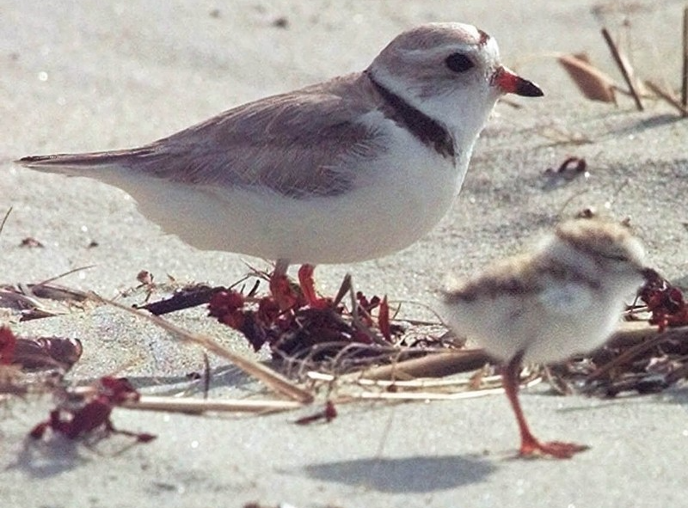
Results: Initial Analyses

Slide 20
1. Correlates of Overall Tone
Tone in other parts of article | Spokespeople | Characteristics of News Source
Headline .51 | Local resident N/S | Season N/S
Body .87 | Local government -.14 | Target N/S
Positive quotes .44 | State government .23 | Type N/S
Neutral quotes -.18 | Federal (not FWS) -.20 | Unique visitors N/S
Negative quotes -.29 | Federal (FWS) .12
 | NGO N/S
 | Other N/S
Enemy Framing
Plover -.47
Laws N/S
Agency N/S
Notes:
We examined correlations between hypothesized predictor variables and overall tone. Correlations range from -1 to 1. A zero is no correlation. A .1 is a low correlation; .3 is medium; .5 or higher is a high correlation. A positive correlation means that the predictor variable and tone had a positive relationship or as one increased the other increased. A negative correlation means that the predictor variable and tone had a negative relationship or as the predictor increased, the tone became more negative. N/S means the correlation between a predictor and overall tone was not statistically significant.
You will see that the strongest correlations are between tone elsewhere in the article and overall tone. This is not surprising. It’s also not surprising that body was the strongest of all predictors as that’s where the bulk of the article is found.
Of the other variables, the plover as the enemy was the strongest correlate. Laws and agency described as the enemy did not relate to the overall tone (you will recall this is defined as the attitude towards plovers in the article).
Some of the types of spokespeople correlated with tone. State government quote(s) in an article were positively correlated with positive tone, as well as FWS quotes but the correlation was not as strong. In contrast non-USFWS federal government quote(s) and local government quote(s) were negatively correlated with tone. It should be noted that just because a type of spokesperson is correlated with a negative article that doesn’t mean they gave negative quotes. It could be because of the types of situations in which that source is quoted. For example, local government quotes were generally neutral (or positive) about finding compromises between two disputing sides – like protecting plovers and local issues like leashing dogs or off road vehicles.
Season, whether the newspaper was a targeted source or not, type of media, and unique visitors for the circulation did not relate to the overall tone.

Slide 21
1. Best Fit Model for Predicting Overall Tone
Step-wise regression analysis with all variables except those related to tone elsewhere in article
R-square = 0.33
 | Standardized Beta
Enemy framing, plovers | -.44
Spokesperson - federal government (non-USFWS) | -.19
Target media | .16
Spokesperson - state government (non-USFWS) | .14
Notes:
We put all of the variables from the previous slide (except those related to tone elsewhere in the article given it’s a component of overall tone, rather than something distinct).
The best fit model had an r-squared of .33, or 33% of the variance in overall tone was explained, which is acceptable.
The standardized betas can be read similar to the regression coefficients. Just four variables are significant predictors when all are considered simultaneously. The strongest is enemy framing about plovers, and then spokesperson – non USFWS, whether the outlet was targeted, and spokesperson – state government.
So these are the most important variables to consider.

Slide 22
2. Profile negative articles
T-test of Positive (n = 96) vs. Negative (n=12) Articles *only significant differences displayed
Notes:
We compared positive vs. negative articles (leaving out neutral) to see what stood out. PLEASE NOTE: only 12 articles were negative so it’s a rather small sample to be considering. Here we show the only 3 characteristics that were statistically significant differences (according to a t-test). The graph shows the percentage of articles with a given characteristic.
You see that enemy framing of plovers was far more prevalent in negative articles than positive articles.
A state government spokesperson was more common in positive articles, as was a USFWS spokesperson.

Slide 23
3. Percentage of all articles with each key word
Notes:
This graph depicts the percentage of all articles in which each of the positive keywords appears. Variations of the word protect was most frequent. etc

Slide 24
3. Percentage of all articles with each key word
Notes:
This graph depicts the percentage of all articles in which each of the neutral keywords appears in descending order.

Slide 25
3. Percentage of all articles with each key word
Notes:
This graph depicts the percentage of all articles in which each of the negative keywords appears in descending order.

Slide 26
3. Keyword Correlates of Tone
From Positive List
educat* .00 | flexibility N/S
open .00 | collaboration N/S
threatened N/S | volunteer .00
cooperat* .00 | work together N/S
protect* N/S | Stewardship N/S
hope N/S | co-exist N/S
hard decisions N/S | balance N/S
shar* .03
success .00
recover* N/S
vulnerable .00
respect N/S
Notes:
We provided the media firm with a list of keywords we expected to be in positive messages. We found that they had little predictive power for tone. Only a few were significant, and all were very weak correlations.

Slide 27
3. Keyword Correlates of Tone Continued
From Neutral List | From Negative List
stake and twine n=0 | stall* -.17
leash .22 | dispute -.14
trash .02 | debate N/S
predator .02 | restrict* N/S
habitat .02 | war N/S
Endangered Species Act N/S | tensions N/S
goal .00 | ban* N/S
record .01 | delay* -.32
decline N/S | block* N/S
fenced-off N/S
rare .00
Notes:
For our list of neutral keywords, we found the same thing. Except leashes. It should be noted that the presence of leash was positively correlated with tone. We often found that leash articles were about why leashes were required (positive/neutral articles).
But, for our negative list, we found that the words stall, dispute, and delay were negatively correlated with tone. So when these words were in an article the tone of the article was more likely to be negative.

Slide 28
3. Messages We Read
Positive
“Cotton balls on toothpick legs”
“Adorable”
Intelligent/Endearing
Easily scared, easily disturbed
Humans should share the beach
Beachgoers and plover advocates should cooperate
Plover breeding success is important
In need of rest/sanctuary after migration
Negative
Less important than human lives
Less important than pets
Less important than human recreational activities
“They can just go somewhere else”
Preventing development projects
Humans have a right to the beach
Laws prevent people from enjoying the beach
Preventing flooding and human safety is more important
Causing loss of tourism revenue
Notes:
We also noted the types of messages we read that were positive or negative.

Slide 29
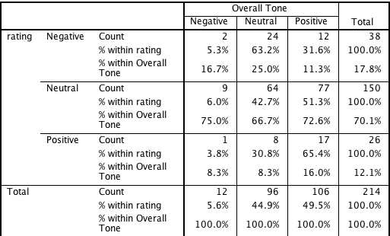
4. Media firm rating of tone vs. read fully
A small positive correlation indicates to some degree but it’s worth the time to have a person read the article!
r = .162 (p = .018)
People read article
Computer coded article

Slide 30
Summary
Main message: Doing well already. Much more positive than negative.
What are the correlates/predictors of the tone?
    Tone in other parts of article most important
    State agency tied to positive articles; non-USFWS federal to negative
    Plover as enemy
    News sources with a close working relationship and/or targeted were more positive
How do negative articles differ from positive?
    Negative = Plover as enemy
    Positive = State government and USFWS spokespeople
What are the messages used in positive articles vs. negative articles?
    Messages of stalling and delaying and dispute = negative
    Surprisingly, leashes = positive
Is the media company’s rating of tone indicative of the tone when we read the article fully?
    To a small degree but it’s worth reading the article fully!

Slide 31
Recommendations
Capitalize on what you’ve been doing; plover media coverage is overwhelmingly positive.
  Except in issues of “stalling” or “delaying” storm recovery efforts
  Think about how to message around resiliency for people & plovers (win-win situations)
Continue to foster relationships with media sources
Counter the negativity in articles (largely aimed at plovers) with positive plover messaging
Consider more emotion-evoking messages
Work more closely with state government who are in positive articles
Consider how to create pro-plover advocates who will be positive local spokespeople (and counter advocates for other causes)
For follow-up study on tone, follow same method & don’t rely on media company’s tone information

Slide 32
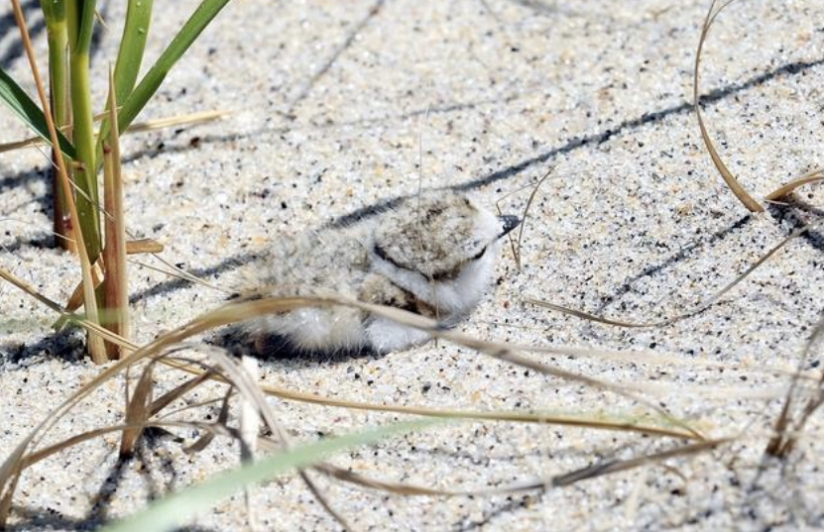
Questions?

